Slide 1
Methyl Acetate Manufacture
Progress Report #1
Team T - Abdul Fayeed, Adarsh Kannan, Gavin Guerrera
March 17th, 2022

Slide 2
Deliverables
Process block diagrams
Spreadsheet level material and energy balances
Preliminary economic analysis

Slide 3
Douglas Method Step 1: Continuous vs. Batch
Product | Desired Amount (MMppy) | Desired Amount (tonnes/yr)
ª (Ac)₂O | 500 | 226,796
^{b} MeOAc | 375 | 170,097
ª Acetic Anhydride
^{b} Methyl Acetate
Production rate of (Ac)₂O and MeOAc are more than 5,000 tonnes/yr
Continuous process

Slide 4
Assumptions: Esterification
The per pass conversion from reactant to product is 100%.
Assume 100% yield (no side reactions in level 1 analysis).
There are four distillation columns which ideally separate the two binary azeotropes present in the system.
Assume reflux ratio is 1.5

Slide 5
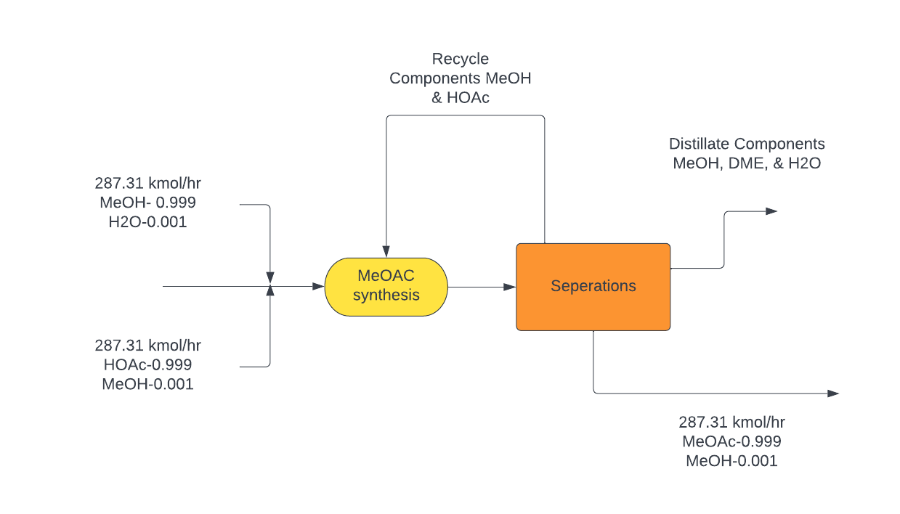
Simplified Esterification BFD

Slide 6
Assumptions: Carbonylation
Per pass conversion in first reactor : 83%¹
Composition of distillate and bottoms fixed (requirement for second feed)
50% D/F ratio for second distillate column.
Fixed composition for second inlet reactor feed.
95% of Methanol from the reactor output is separated in the distillate.
Per pass conversion in second reactor: 99%.
Assume reflux ratio is 1.5
¹ R. Bertrum Diemer and William L. Luyben Industrial & Engineering Chemistry Research 2010 49 (23), 12224-12241, DOI: 10.1021/ie10158zj

Slide 7
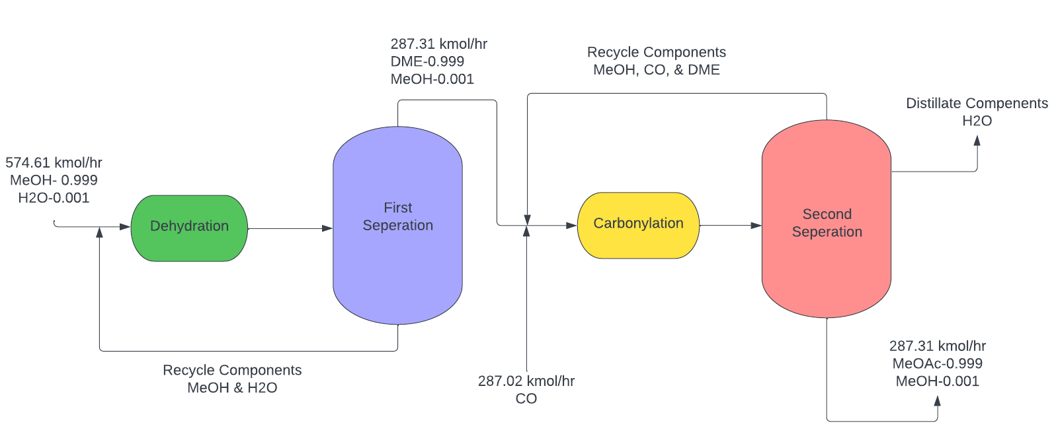
Simplified Carbonylation BFD

Slide 8
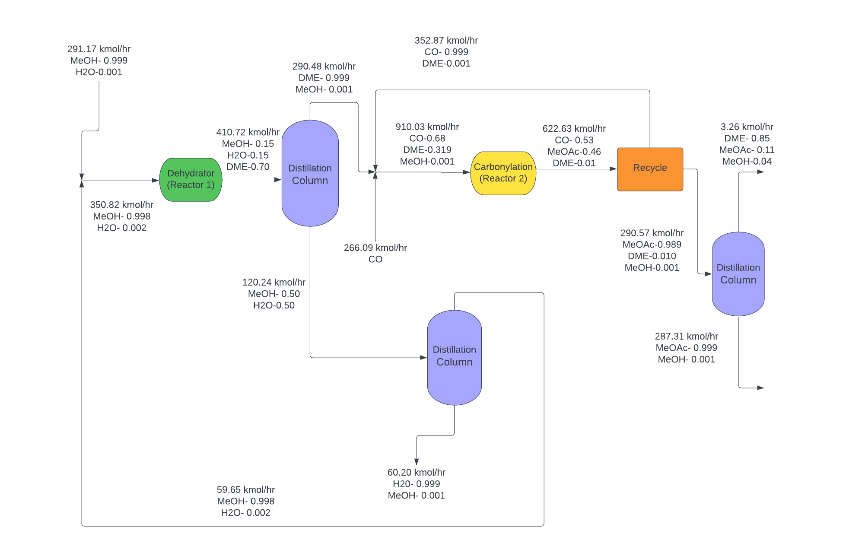
Rigorous Carbonylation BFD ¹
¹ R. Bertrum Diemer and William L. Luyben Industrial & Engineering Chemistry Research 2010 49 (23), 12224-12241, DOI: 10.1021/ie10158zj

Slide 9
Equipment Requirement: Esterification
Double binary azeotrope between MeOH-MeOAC and MeOAc-H₂O, so would need at least 4 distillation columns for separation purposes.
One packed-bed reactor for the esterification process.
Thus, number of operators are 4 for the process.
AcOH is corrosive to mild steel (carbon steel), hence stainless steel (F_{M}=2) is used.

Slide 10
Equipment Requirement: Carbonylation
Binary azeotrope between DME and H₂O (requires at least two distillation columns), and another distillation column to separate MeOAc and DME.
Two reactors: one for the dehydration, and the other for carbonylation.
Thus, number of operators are 4 for the process.
MeOAc, DME, CO, H₂O and MeOH do not have corrosion/ handling issues like AcOH, so carbon steel can be utilized

Slide 11
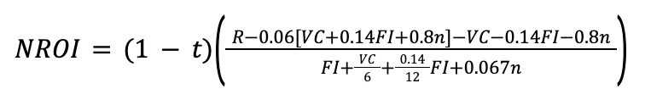
Preliminary Economic Analysis
Total VC carbonylation: $106MM (MeOH + CO)
Total VC esterification: $283MM (MeOH + HOAc)
VC dominated by the high price of AcOH compared to other raw materials
Number of employees: 4 for each route

Slide 12
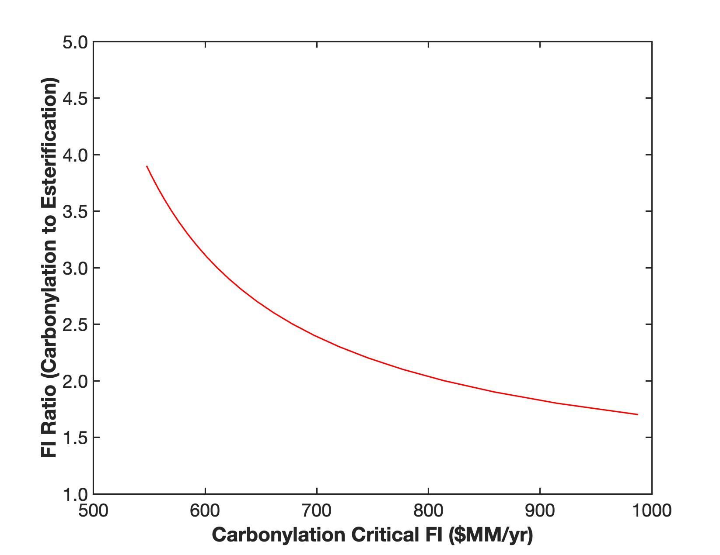

Slide 13
Preliminary Conclusions
Based on the locus of critical investment values, it is clear that carbonylation has higher feasibility than esterification.
This is further substantiated by the high conversion rate assumed for esterification (which is unlikely due to this reaction being in equilibrium).

Slide 14
Limitations
Assuming no side reactions implies that input feeds are underestimated compared to values used in the actual process, further increasing variable cost.
Addition of side reactions (in Level 2) would imply additional materials which require separation, which could further increase equipment and variable cost.
In the case of esterification, it is assumed that conversion is 100%, which is not possible. Furthermore, reactions in equilibrium have ideal conversions of about 50%-70% .

